Slide 1


Research Storage Simplified
RC Account
Registration
John Reiland
Processing Data at Scale

Slide 2

View the Slides
https://github.com/ResearchComputing/Processing_Data_At_Scale

Slide 3









Meet the User Support Team
Layla Freeborn
Brandon Reyes
Andy Monaghan
Michael Schneider
John
Reiland
Dylan Gottlieb
Mohal Khandelwal
Ragan
Lee
3

Slide 4


Workshop Overview
HPC Basics
Slurm Jobs
Dask Library

Slide 5


Ask Questions
Discuss Ideas

Slide 6

Practice Project – Counting Words
Project Gutenberg –
Free e-book repository
Started by Michael Hart (creator of first e-book)
Structured, but poorly formatted
Notes:
Simple process – but not only does it provide a good overview of the techniques discussed today, but we will also be modeling good engineering practices:
- Start with a small easily understood (and verified) task before trying to handle larger/more complex tasks.

Slide 7



Accessing Gutenberg Files
Gutenberg Project
Web Scraping Tips
Downloading Files

Slide 8
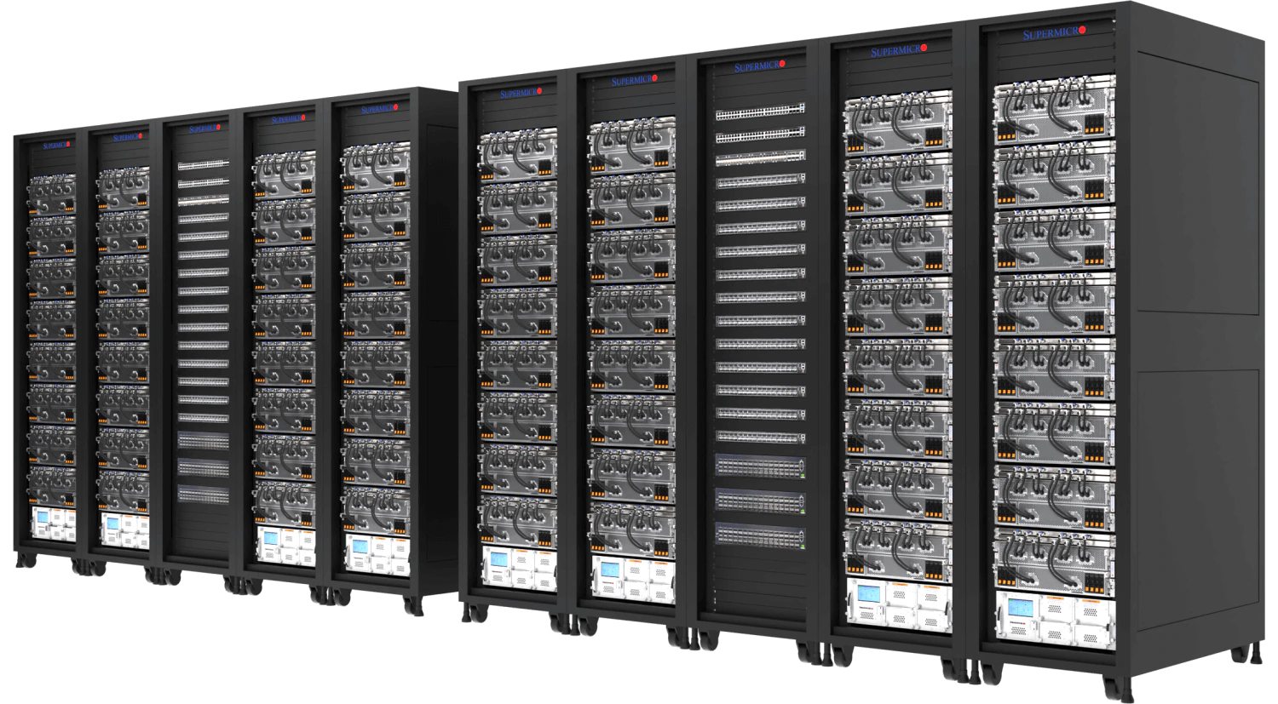

What is HPC?
Scale
vs
Speed

Slide 9
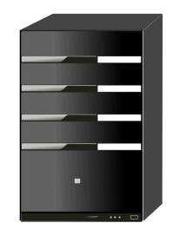
What can I use HPC for?
Tiny Job
Tiny Job
Big Job
Tiny Job
Serialized Jobs
Parallelized Job

Slide 10


CURC HPC Resources
Alpine Cluster
Data
Storage
Software
Modules

Slide 11



CURC HPC Resources
Alpine Cluster
Data
Storage
Software
Modules

Slide 12
Alpine Partitions
amilan
General Usage
Notes:
amilan:
285 Nodes
64 CPU Cores per Node
3.75 GB of RAM per CPU (240 GB total)
Detailed Information on Alpine Hardware: https://curc.readthedocs.io/en/latest/clusters/alpine/alpine-hardware.html

Slide 13
Alpine Partitions
amilan
General Usage
amem
High Memory
Notes:
amem:
22 Nodes
48 CPU Cores per node (12)
64 CPU Cores per node (10)
21.5 GB of RAM per CPU (1 TB total)
Detailed Information on Alpine Hardware: https://curc.readthedocs.io/en/latest/clusters/alpine/alpine-hardware.html

Slide 14
Alpine Partitions
amilan
General Usage
aa100
Nvidia GPU’s
amem
High Memory
Notes:
aa100
12 Nodes
64 CPU Cores per Node
3.75 GB of RAM per CPU (240 GB total)
3 GPU’s per Node (Nvidia A100)

Slide 15
Alpine Partitions
amilan
General Usage
aa100
Nvidia GPU’s
amem
High Memory
ami100
AMD GPU’s
Notes:
ami100
8 Nodes
64 CPU Cores per Node
3.75 GB of RAM per CPU (240 GB total)
3 GPU’s per Node (AMD MI100)
Detailed Information on Alpine Hardware: https://curc.readthedocs.io/en/latest/clusters/alpine/alpine-hardware.html

Slide 16

CURC Web Portal

Slide 17

Data Storage
Core
PL
Personal Storage
Includes 3 Directories
/home (2 GB)
/projects (250 GB)
/scratch (10 TB)
PetaLibrary
Tiered Storage
Active, Archive
Requires Funding
Starts at 1 TB

Slide 18
Copy Files
CP – Copy command
$ cp /pl/active/courses/2025_spring/CMCI_LL/txt-files.tar
/scratch/alpine/$USER/txt-files.tar
$ cp /pl/active/courses/2025_spring/CMCI_LL/code.tar
/projects/$USER/code.tar

Slide 19
Extract Files
tar – extract or “unzip” files command
$ cd /scratch/alpine/$USER
$ tar -xvf txt-files.tar
$ cd /projects/$USER
$ tar -xvf code.tar

Slide 20



Dataset Structure
1/
pg1.txt
cache/
2/
pg2.txt
epub/
n/
pgn.txt
/scratch/alpine/$USER/cache/epub/n/pgn.txt

Slide 21
Manually counting words
wc -w <file name>

Slide 22

Anatomy of a job script
#!/bin/bash
## Directives
#SBATCH --<option>=<value>
## Software
module load <software>
## User scripting
<command>
Batch Jobs

Slide 23
job.sh
#!/bin/bash
#SBATCH --nodes=1
#SBATCH --ntasks=1
#SBATCH --time=00:20:00
#SBATCH --partition=amilan
#SBATCH --output=slurm_logs/serial-%j.out
JOB=$SLURM_JOB_ID
TASK=0
START=0
END=10
./count_words.sh "$JOB" "$TASK" "$START" "$END"

Slide 24

Submitting a Batch Job
1
Login Node

Slide 25

Submitting a Batch Job
1
2
Login Node
Submit Job
$sbatch <job_file> <other-directives>

Slide 26


Submitting a Batch Job
1
2
3
Login Node
Submit Job
Job Queue
$squeue -u <username>
$sacct -u <username>

Slide 27

Cores != Performance

Slide 28

Checking Job Performance
$ module load slurmtools
$ seff <job number>
Job ID: 8636572
Cluster: alpine
User/Group: ralphie/ralphiegrp
State: COMPLETED (exit code 0)
Nodes: 1
Cores per node: 24
CPU Utilized: 04:04:05
CPU Efficiency: 92.18% of 04:24:48 core-walltime
Job Wall-clock time: 00:11:02
Memory Utilized: 163.49 MB
Memory Efficiency: 0.14% of 113.62 GB
Monitoring Resources

Slide 29

Job Arrays
array.sh
Notes:
Discuss seff-array
Discuss watching time with sacct
Sacct –j <job id> -X -o jobid,elapsedraw
Sacct –j <job id> -B

Slide 30
Scaling with Dask

Slide 31

Creating an Anaconda Environment
$ module load anaconda
$ conda create -n dask
$ conda activate dask
$ conda install dask -c conda-forge
$ conda install -c conda-forge jupyterlab
Kernel:
$ conda install -y ipykernel
$ python -m ipykernel install --user --name dask --display-name dask
Jupyter Session
Notes:
Walk through how to launch a jupyter notebook via OnDemand
Discuss the limitations of a notebook – This is only meant for dev / testing. It can’t really support large workflows!
Mention how to troubleshoot a session:
Can only have 1app running
Can also see log by clicking the link under the session – handy if it closes unexpectedly

Slide 32
Execute Jupyter Notebook
jupyter execute <notebook.ipynb>

Slide 33

Where to go next?
Discuss python libraries:
Multiprocessing
Cuda and optimized ml libraries for mpi
MPI enabled libraries and compiling c++ code
R libraries – futures
CRDDs office hours and other workshops.
CRDDS Events &
Office Hours

Slide 34

Documentation
https://curc.readthedocs.io/en/latest/

Slide 35

Survey and feedback
Survey: http://tinyurl.com/curc-survey18
Notes:
Update link to include a different survey for collecting information from attendees

